Slide 1




Kiến tạo tương lai
THEO CÁCH CỦA BẠN
www.viettel.com.vn

Slide 2


Online
Learning
www.viettel.com.vn

Slide 3
Câu hỏi
1. Online learning là gì?
2. Online learning khác gì so với cách học thường dùng ?
3. Khi nào nên áp dụng online learning?
www.viettel.com.vn

Slide 4
Tổng quan
Supervised Learning – Model trained on a labelled dataset
Unsupervised Learning – Model trained on an unlabelled dataset
Reinforcement Learning – Models trained to take suitable action for the highest reward
Active Learning – Models that trained with few active labels to achieve high performance
Transfer Learning – Model is first trained on one task, then a part of it is deployed to another model for training
Online learning – Model that is constantly updated by a real-time stream of data
www.viettel.com.vn

Slide 5
Vì sao cần có online learning
Traditionally machine learning is performed offline, called Offline Learning, which means we have a batch of data, and we optimize an equation. However, if we have streaming data, we need to perform online learning, so we can update our estimates as each new data point arrives rather than waiting until “the end” (which may never occur)
what if there is a continuous stream of new data that the model has to learn on the spot?
www.viettel.com.vn

Slide 6
Giới thiệu về online learning
Online learning – Model that is constantly updated by a real-time stream of data
Online learning is an approach used in Machine Learning that ingests sample of real-time data one observation at a time.
Online learning models process one sample of data at a time – thus be significantly more efficient both in time and space with more practical batch algorithms.
www.viettel.com.vn

Slide 7
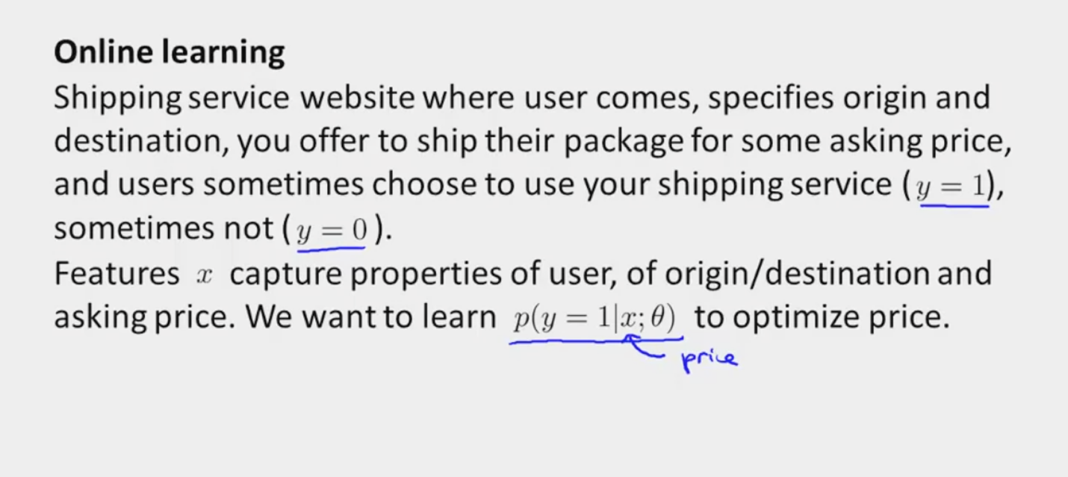
Ví dụ về online learning
www.viettel.com.vn

Slide 8
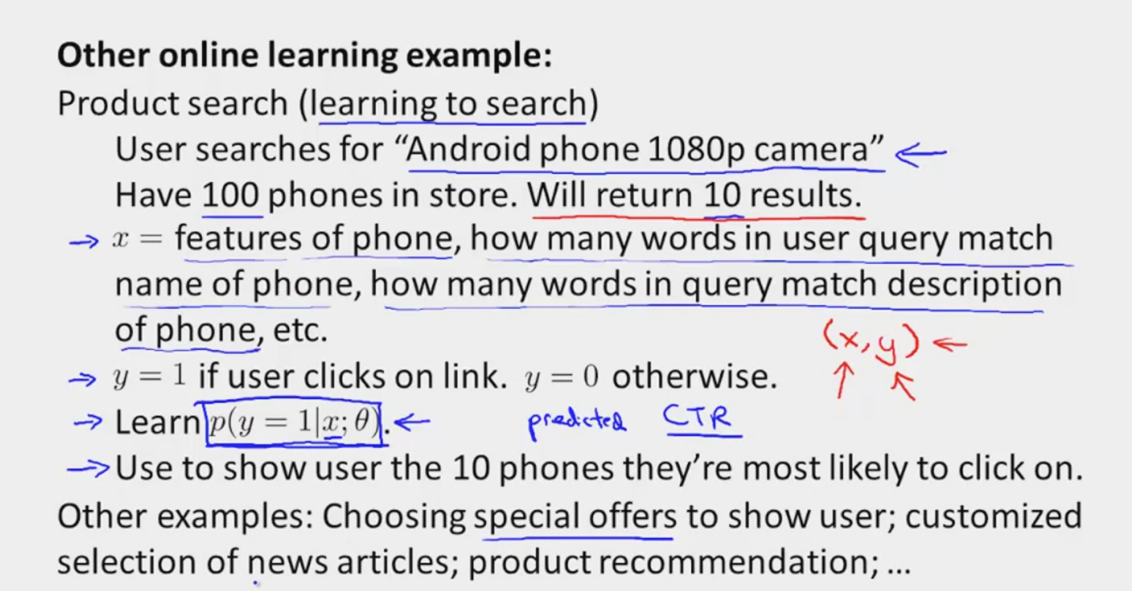
Ví dụ về online learning
www.viettel.com.vn

Slide 9
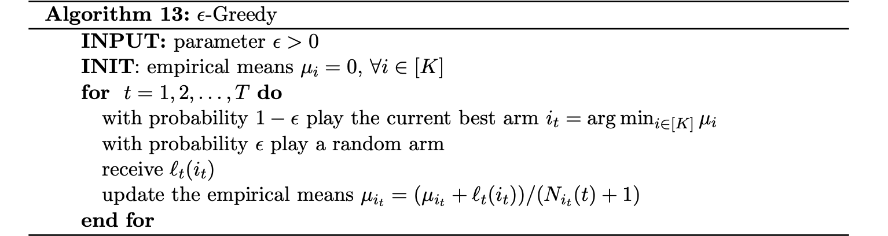
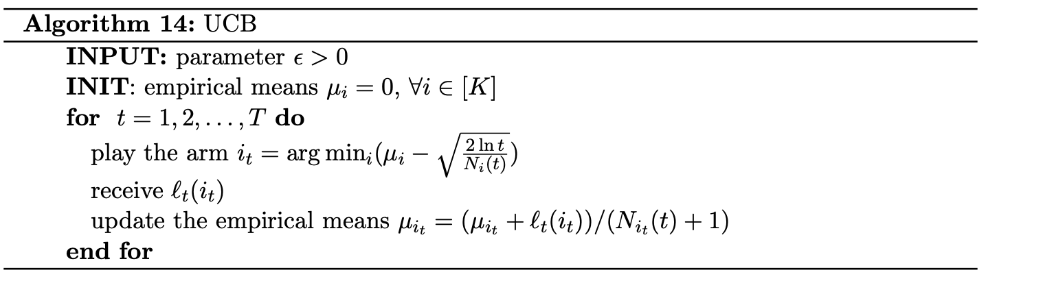
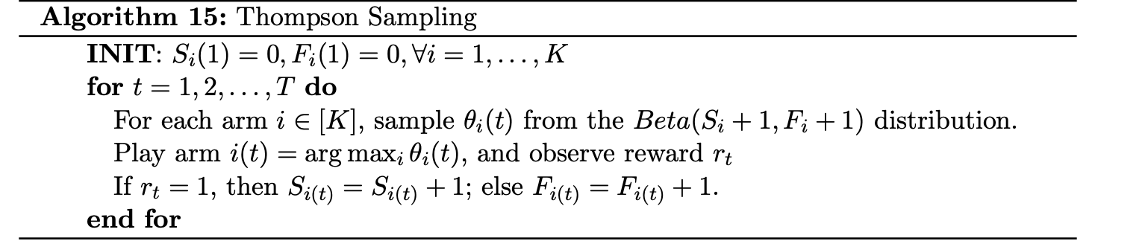
Ứng dụng online learning
www.viettel.com.vn

Slide 10
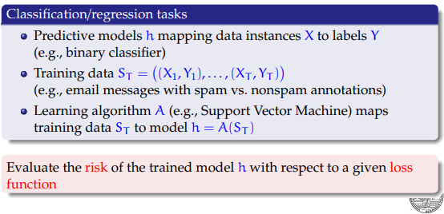
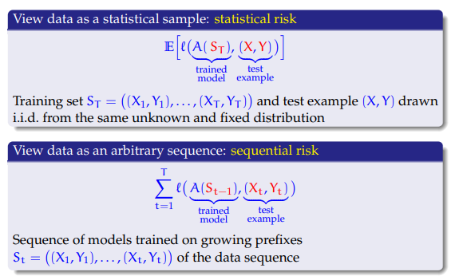
Regret of online learning
www.viettel.com.vn

Slide 11
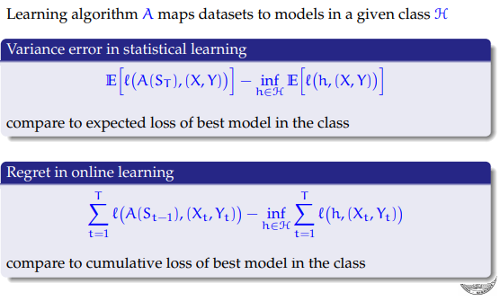
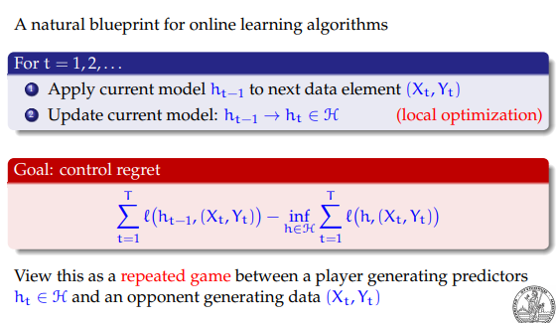
Regret of online learning
www.viettel.com.vn

Slide 12
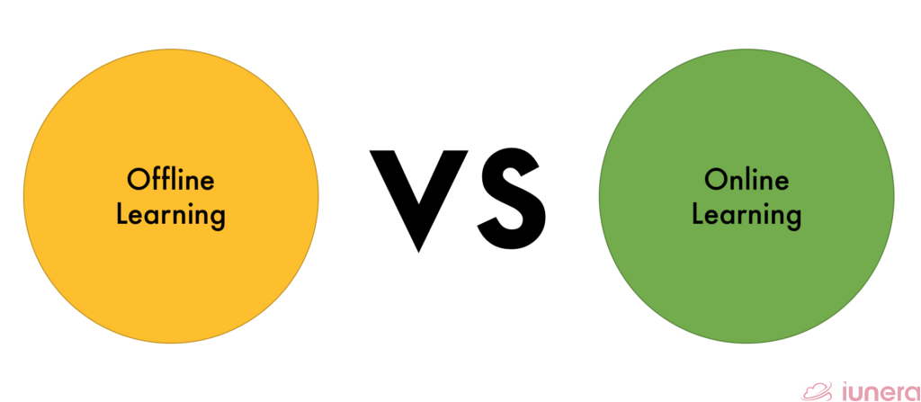
Phân biệt batch learning và online learning
When do we need Offline or Online learning in Data Science? It depends on what are you looking to do with the model..
www.viettel.com.vn

Slide 13
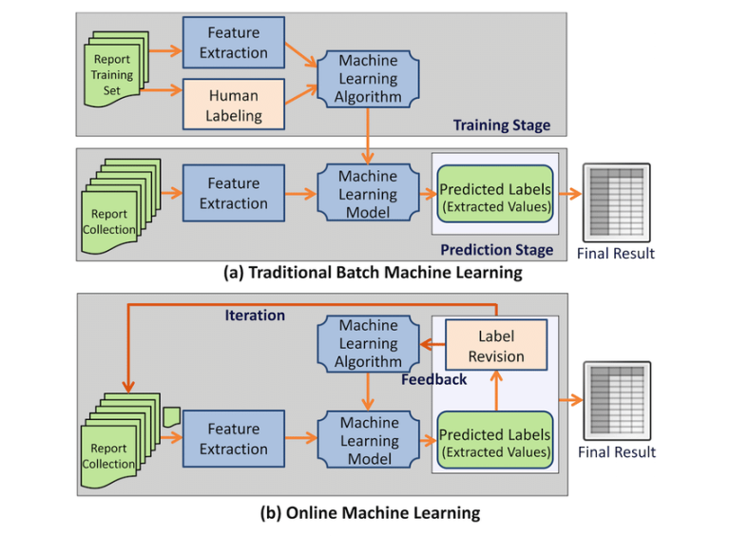
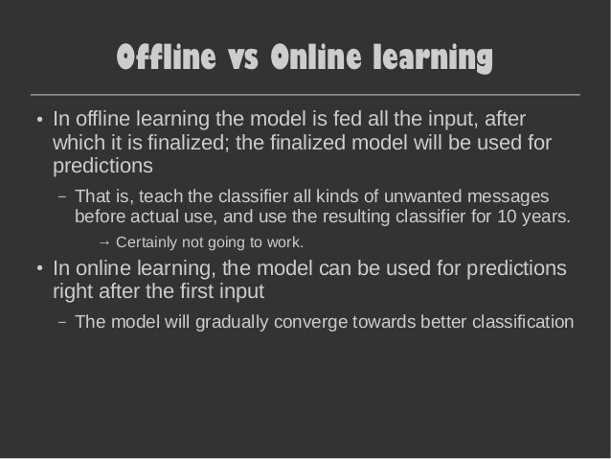
Phân biệt batch learning và online learning
www.viettel.com.vn

Slide 14
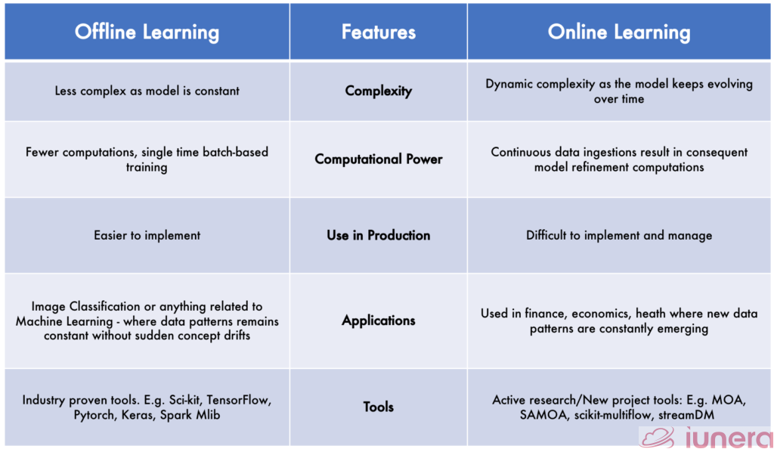
Phân biệt batch learning và online learning
Model Training and Complexity
Computation Timing
Use in Production
www.viettel.com.vn

Slide 15
Phân biệt batch learning và online learning
Computationally much faster and more space efficient.
Usually easier to implement
More difficult to maintain in production
More difficult to evaluate online
Usually more difficult to get “right”
www.viettel.com.vn

Slide 16
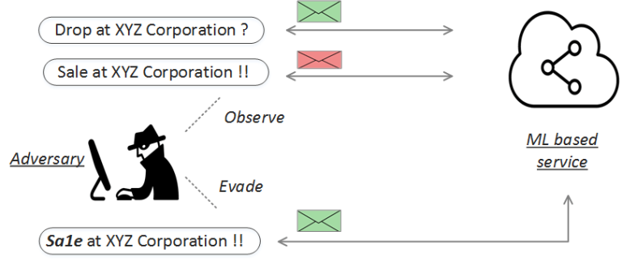
When to use Online Learning methods in Machine Learning?
Similar to traditional (batch) machine learning methods, online learning techniques can be applied to solve a variety of tasks in a wide range of real-world application domains.
Supervised learning tasks: spam email filtering, stock price prediction, …
Bandit learning tasks: Multi-armed bandits (MAB) -Recommender systems
Unsupervised learning tasks: online cluster
www.viettel.com.vn

Slide 17
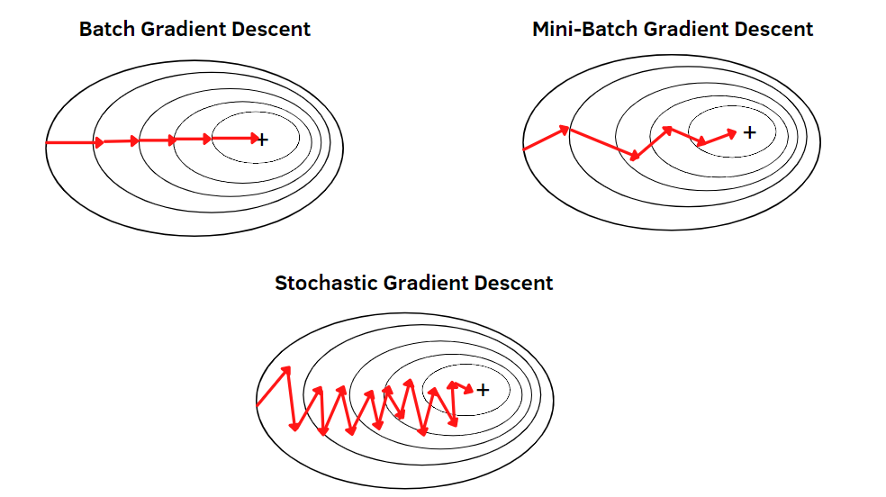
SGD và GD
Batch Gradient Descent: all the training
data is taken into consideration to take a single step. We take the average of the gradients of all the training examples and then use that mean gradient to update our parameters. So that’s just one step of gradient descent in one epoch
Stochastic Gradient Descent (SGD):
consider just one example at a time to take a single step
www.viettel.com.vn

Slide 18
Mini-batch Gradient Descent
Mini-batch gradient descent finally takes the best of both worlds and performs an update for every mini-batch of n training examples
Reduces the variance of the parameter updates, which can lead to more stable convergence; and
Can make use of highly optimized matrix optimizations common to state-of-the-art deep learning libraries that make computing the gradient w.r.t. a mini-batch very efficient.
Common mini-batch sizes range between 50 and 256, but can vary for different applications. Mini-batch gradient descent is typically the algorithm of choice when training a neural network and the term SGD usually is employed also when mini-batches are used
www.viettel.com.vn

Slide 19
Online Gradient Descent vs SGD
what the difference between stochastic gradient descent and online gradient descent is? Or is it the same algorithm?
www.viettel.com.vn

Slide 20
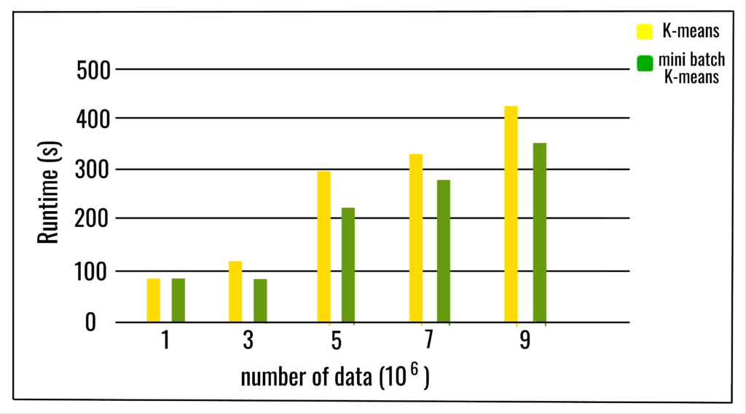
Mini Batch Kmean vs Kmeans
The MiniBatchKMeans is a variant of the KMeans algorithm which uses mini-batches to reduce the computation time, while still attempting to optimise the same objective function. Mini-batches are subsets of the input data, randomly sampled in each training iteration. These mini-batches drastically reduce the amount of computation required to converge to a local solution
www.viettel.com.vn

Slide 21
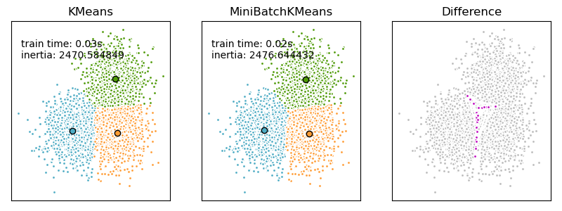
Mini Batch Kmean vs Kmeans
MiniBatch K-Means converges faster than K-Means, but the quality of the results is reduced. In practice this difference in quality can be quite small, as shown in the example and cited reference
www.viettel.com.vn

Slide 22
Open source
MOA (Massive Online Analysis): A framework for data stream mining, written in Java.
Developed at The University of Waikato, where popular machine learning framework WEKA was also developed, MOA is one of the most popular open-source tools for training machine learning models on streaming data. MOA currently supports stream classification, stream clustering, outlier detection, change detection and concept drift and recommender systems.
Scikit-multiflow: Inspired by MOA, scikit-multiflow is an open source machine learning
framework for multi-output/multi-label and stream data, developed for Python.
StreamDM: Developed at Huawei Noah’s Ark Lab, streamDM is an open-source tool for
mining big data streams using Spark Streaming.
www.viettel.com.vn

Slide 23
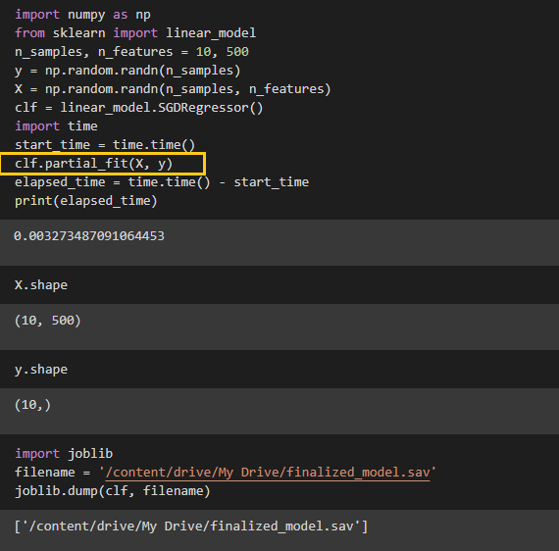

Ví dụ
www.viettel.com.vn

Slide 24
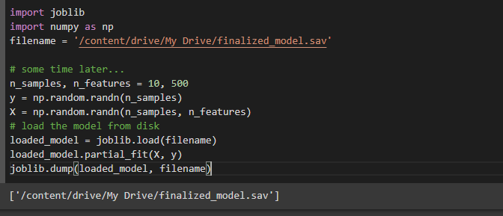

Ví dụ
www.viettel.com.vn

Slide 25
References
https://arxiv.org/pdf/1802.02871.pdf
https://medium.com/value-stream-design/online-machine-learning-515556ff72c5
https://www.iunera.com/kraken/fabric/simple-introduction-to-online-learning-in-machine-learning/#3-model-training-and-complexity
https://www.analyticsvidhya.com/blog/2015/01/introduction-online-machine-learning-simplified-2/
https://en.wikipedia.org/wiki/Online_machine_learning#External_links
https://www.mit.edu/~rakhlin/6.883/
https://codeburst.io/realtime-machine-learning-online-learning-with-pubnub-2005e86670ad
https://upcommons.upc.edu/bitstream/handle/2117/23414/R13-8.pdf
https://simons.berkeley.edu/sites/default/files/docs/5318/slides.pdf
www.viettel.com.vn

